Slide 1



Slide 2
Write for a Living
Session 3:
Mentors: Elisheva Aeder, Miriam Herman, Daniella Penn
Learn: Ruby on Rails

Slide 3
What is Ruby on Rails?
Ruby on Rails is a FRAMEWORK for building websites.
It’s a basic structure, or pattern that all your web apps can follow,
making it easy to determine what goes where.
Three letters to remember:
MVC

Slide 4
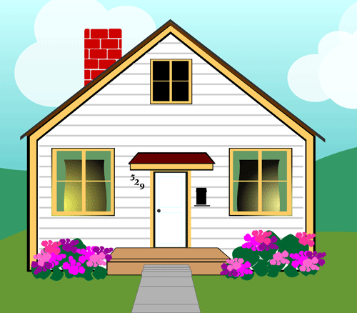
If you were building a house, you’d have different pieces of architecture to take care of different functions.
Roof to keep your head dry
Walls to keep out bad neighbors
Door to let friends in

Slide 5
When building a web app, you’ll need to:
Models
1) Talk to Your Data
2) Display to Your Users
3) Negotiate Traffic Between the 2
*possible reordering to have models flow to controllers
Views
Controllers

Slide 6
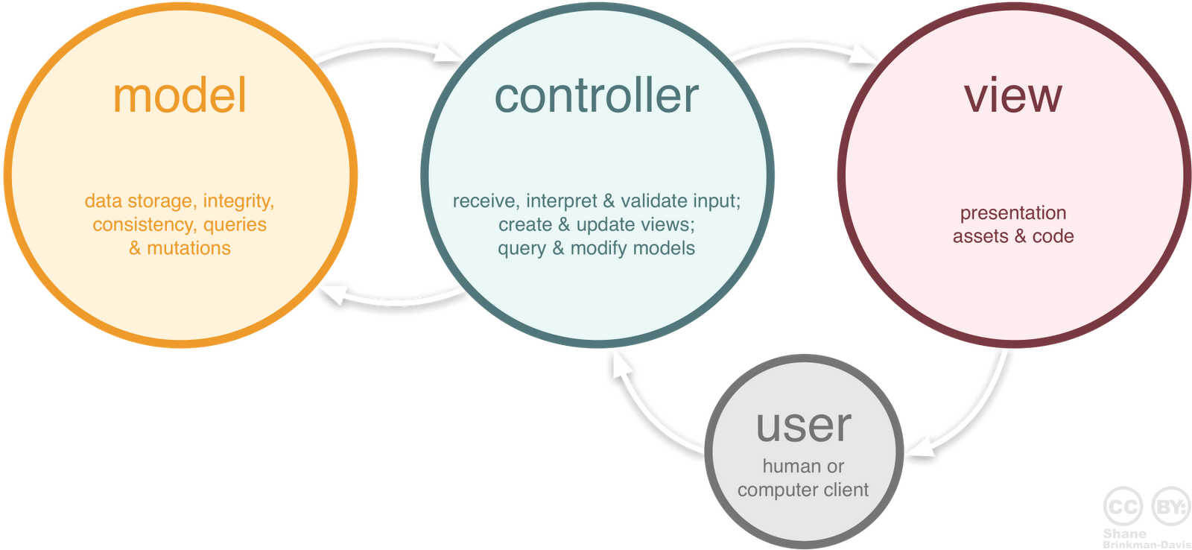
MVC

Slide 7
Let’s Do This Thing.
Crowded slide
Creating a brand new Rails project:
If you don’t have Ruby on Rails yet, type gem install rails into your terminal
Navigate to a folder where you want to keep your project
Type rails new [name of project]
You will have a new folder with the name of your project. Cd into it, and open it using your text editor
The “app” folder is where you’ll do most of your work
Open it up, and check out the folders. Do any of them sound familiar?
Rails App in Action:
In your project folder, type Rails Server (or Rails S)
Type localhost3000 in your browser

Slide 8
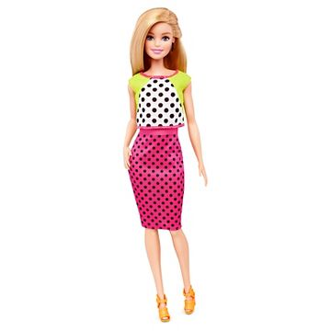

I have an app! Now what?
Have a lag from first txt box to second so they can think
Models.
What kind of data do we want to hold on to?
What are the “objects” or “classes” we’ll hold in our app?
The Major Characters:
Airbnb
Blog/Twitter
Facebook
What attributes will each have? How are they connected?

Slide 9
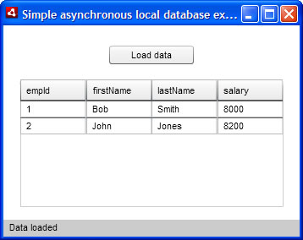
SQL Database
Unique ID
Assigned every time an item is saved to the database

Slide 10

Yeah that was a lot.
Let’s slow down.

Slide 11
Generating Models, and other stuff
To generate a Feed model, type:
Rails generate scaffold Feed name:string url:string description:string
This will generate a Feed model (Ruby class) for Feed, with a couple attributes (name, url, and description.
Rails generate model Feed will do that too. But the “scaffold” command comes with a host of extras:
A migration file in db/migrate, which will create the database
A feeds_controller in your controllers folder with seven methods already laid out
Resources :feeds routes in your config/routes.rb folder
7 view files that correspond to the 7 controller methods

